Slide 1



Use of In-Situ Geotechnical Tests for Foundation Systems
The XXVI Széchy Lecture, Budapest
Paul W. Mayne, PhD, P.E.
Georgia Institute of Technology, USA
14 February 2020

Slide 2

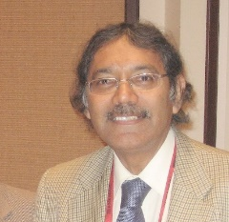

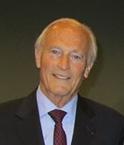

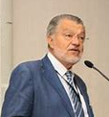
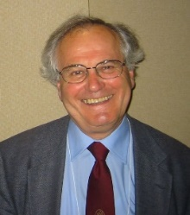
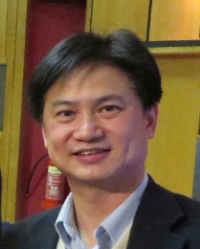
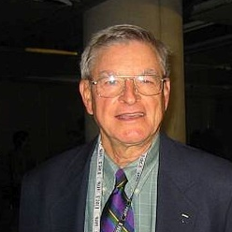
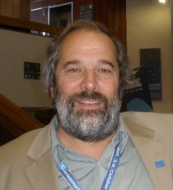
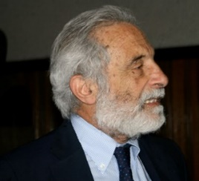


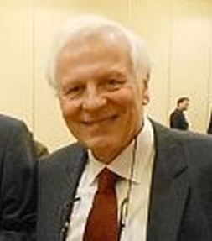
Past Széchy Lectures
2001 - Robert Mair
2002 - Mike Jamiolkowski
2003 - James K. Mitchell
2004 - Suzanne Lacasse
2006 - Pedro Seco e Pinto
2007 - Serge Varaksin
2008 - Roger Frank
2010 - William Van Impe
2011- Jean Louis Briaud
2013 - John Burland
2014 - Carlo Viggiani
2015 - Rainer Massarsch
2017- J.P. Giroud
2019 Charles Ng

Slide 3
Purposes: Geotechnical Site Investigation
A must prior to all geotechnical projects
Determine geostratigraphy for site development
Obtain information for construction and foundation selection or ground modification
Collect geotechnical data for parameter evaluation
Input to analytical models and numerical FEM
Minimize surprises during construction
Mitigate potential for legal involvement

Slide 4
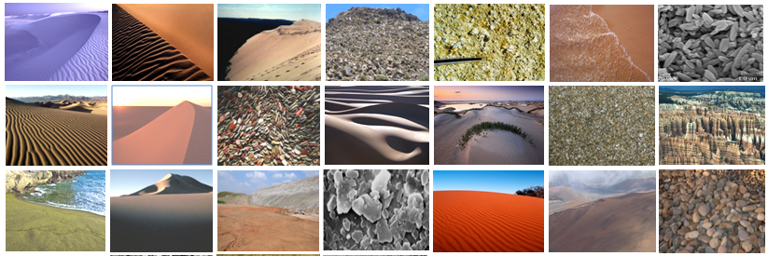
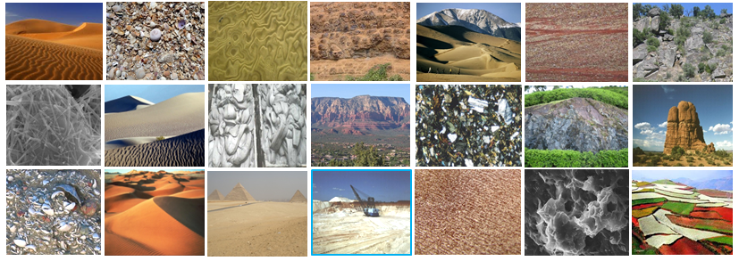
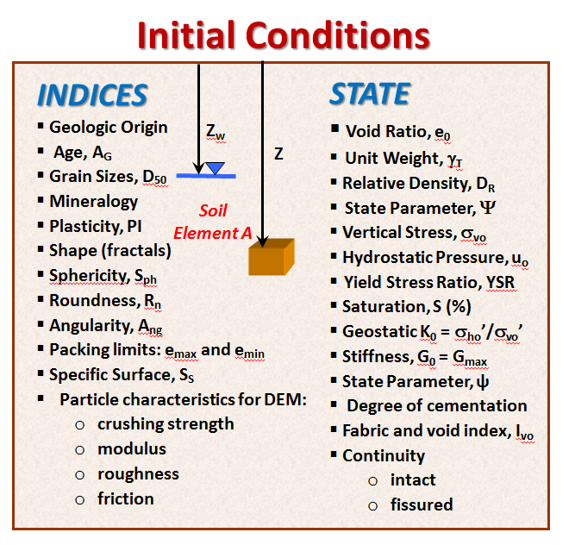
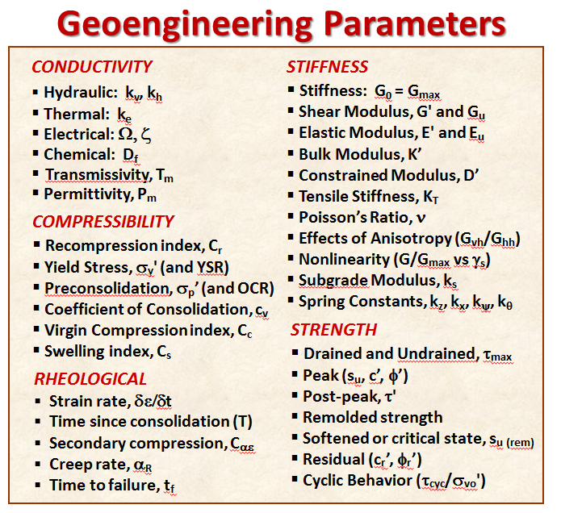
Geomaterial Characteristics

Slide 5
“...when you can measure what you are speaking about and express it in numbers, you know something about it; but when you cannot express it in numbers, your knowledge is of a meager and unsatisfactory kind" Lord Kelvin (1883)

Slide 6
Selection of In-Situ Geotechnical Tests
SPT
SPLT
PMT
TSC
Full Flow Penetrometers
SPTT
TxPT
SWS
MPT
RapSochs
SCPMTù
CPMT
RCPTu
DMTà
LPT
VST
PV
BPT
PBPT
DP
DMT
K₀SB
HF
CPTu
TBPT
PPT
CPTù
PLT
FTS
SCPTu
BST
CPT
SDMT
HPT
DEPPT
TPT HBPT
SPT = Standard Penetration Test
TxPT = Texas Penetration Test
VST = Vane Shear Test
PMT = Pressuremeter Test
CPMT = Cone Pressuremeter
DMT = Dilatometer Test
SPLT = Screw Plate Load Test
ISB = Iowa K₀ Stepped Blade
SWS = Swedish Weight Sounding
HF = Hydraulic Fracture
BST = Borehole Shear Test
DPT = Dynamic Probings
TCPT = thermal penetrometer test
TSC = Total Stress Cell (spade cell)
FTS = Freestand Torsional Shear
PV = Piezovane
MPT = Mackintosh Probe Test
CPT = Cone Penetration Test
CPTu = Piezocone Penetration
RCPTu = Resistivity Piezocone
SCPTu = Seismic Cone
SDMT = Seismic Flat Dilatometer
TBPT = T-Bar Penetrometer Test
BPT = Ball Penetrometer
TPT = Toroid Penetrometer Test
PDP = Panda Dynamic Penetrometer
PPT = Plate Penetration Test
PLT = Plate Load Test
HPT = Helical Probe Test
PBPT = Piezoball Penetration Test
RapSochs = Rapid Soil Characterization System
CPTù = Piezodissipation Test
DMTà = Dilatometer with A-reading Dissipations
SPTT = Standard Penetration Test with Torque
LPT = Large Penetration Test
DEPPT = Dual Element PiezoProbe Test
HBPT = hemi-ball penetration test
SCPMTu = Seismic Piezocone Pressuremeter
ISEEP = In-Situ Erosion Evaluation Probe

Slide 7
Topics Suggested by Dr. András Mahler
Flat Plate Dilatometer (DMT) and its application to foundations
Interpret in-situ test data in OC Soils
Overburden release from deep excavations
Cone Penetration Test (CPT) for shallow foundations
  Elastic continuum theory
  Direct CPT approach
Role of shear wave velocity (V_{s}) for shallow and deep foundations, i.e. SCPTU

Slide 8

FLAT DILATOMETER TEST (DMT)
ASTM D 6635
N₂
Push Rate
= 20 mm/s
Tubing
with wire
Pressure
Gages
ground surface
Gas Cylinder
Rods
Calibration of Membrane
Stiffness in Air:
ΔA = 10 to 20 kPa (suction)
ΔB = 10 to 40 kPa (inflation)
Note: both are positive values
PLAN
VIEW
PROFILE VIEWS:
1. Push blade 0.2 m (or 0.3 m) increments
2. A-reading when membrane δ = 0.0 mm
3. B-reading when membrane δ = + 1.1 mm
4. Deflate rapidly and repeat
Inflatable circular
steel membrane
diameter = 60 mm
Stainless Steel Blade
length = 240 mm
sensing
pin
width = 95 mm
thickness = 15 mm
18° angle
membrane
deflects, δ
CORRECTED PRESSURE READINGS
DILATOMETER INDICES
p₀ = contact pressure
= 1.05(A+ΔA) - 0.05 (B-ΔB)
p₁ = expansion pressure = B -ΔB
I_{D} = (p₁-p₀)/(p₀-u₀) = DMT material index
E_{D} = 34.7 (p₁ - p₀) = dilatometer modulus
K_{D} = (p₀ - u₀)/σ_{vo}' = horizontal stress index

Slide 9
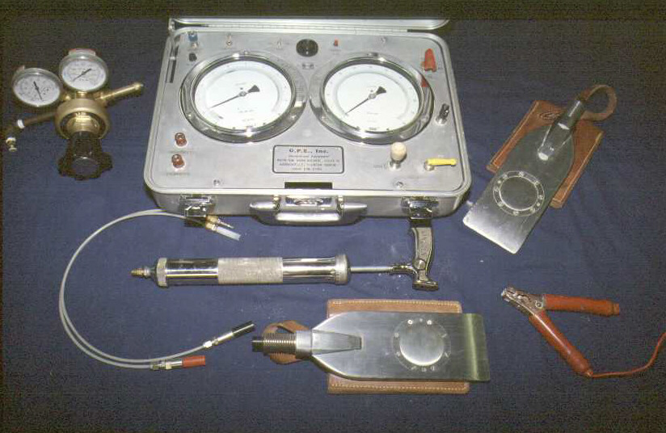
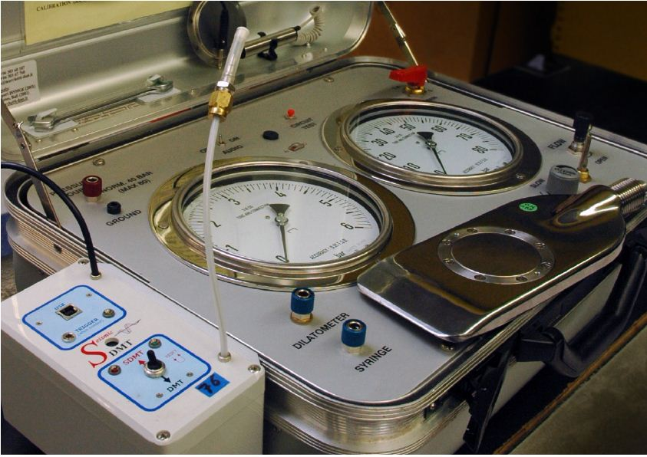
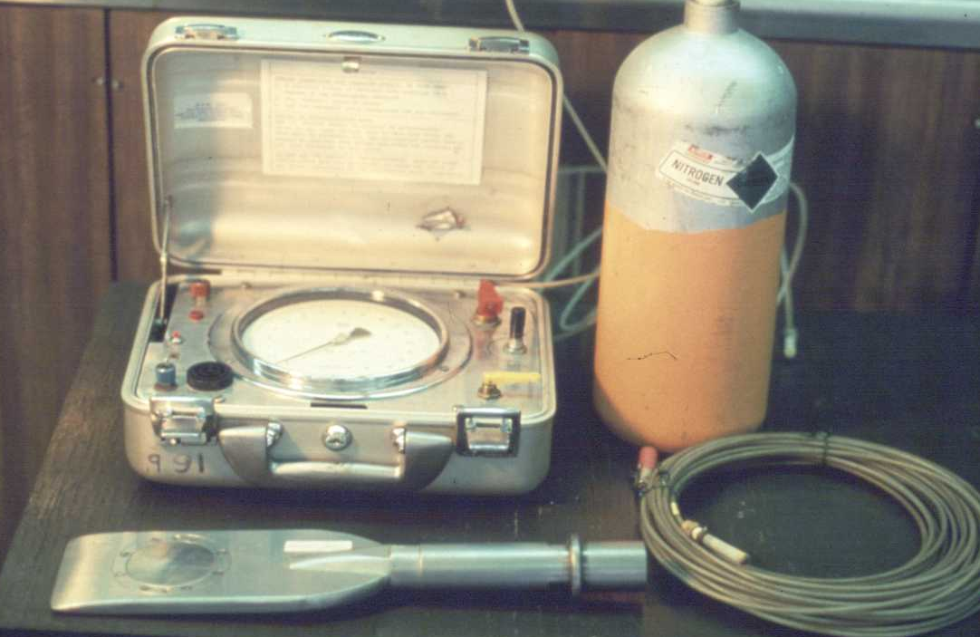
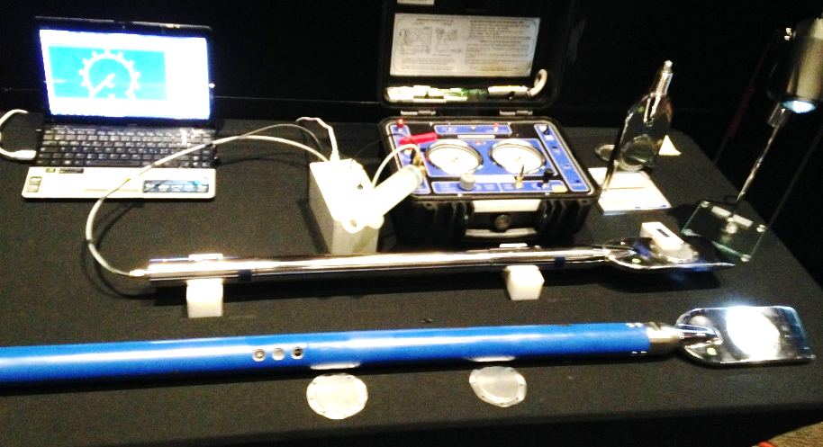
Flat Plate Dilatometer Test (DMT)
1990 2006 SDMT
1975 original 2016 Medusa - Auto-DMT

Slide 10
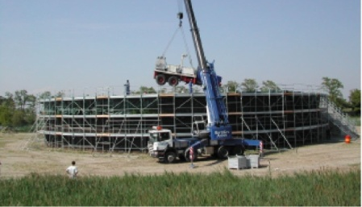
DMT-14 Venetian Lagoon
Dilatometer Test
Moduli:
E = 2G(1+ν)
M = 1/m_{v}
Treporti Embankment

Slide 11
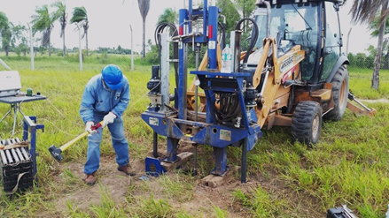
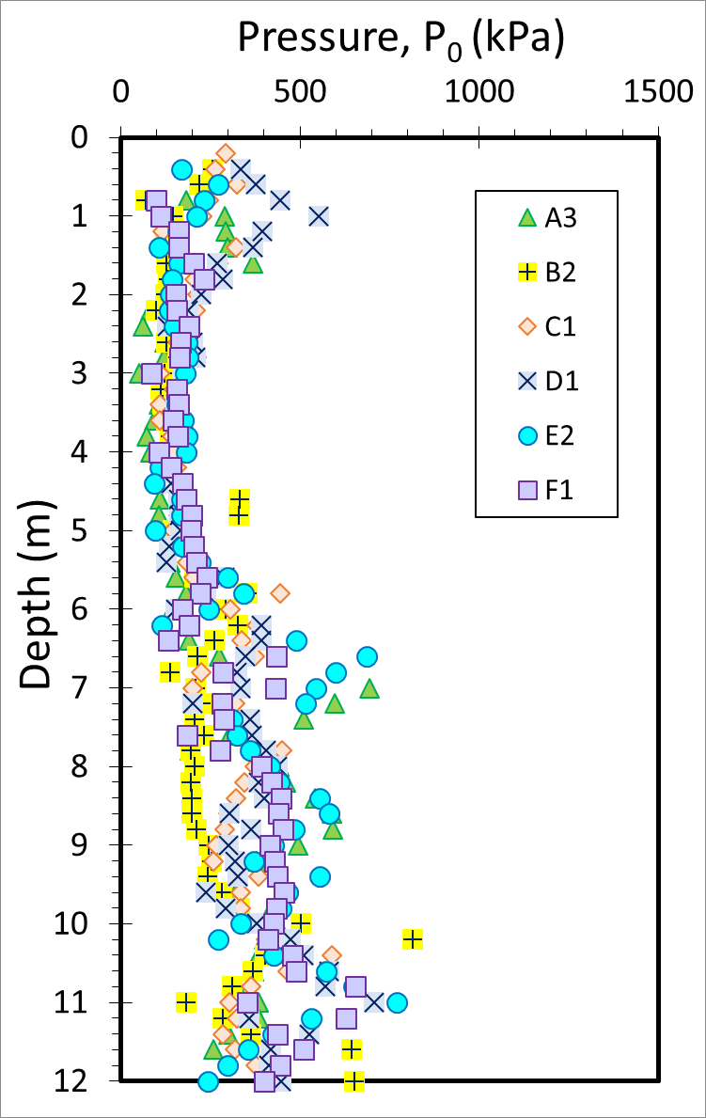
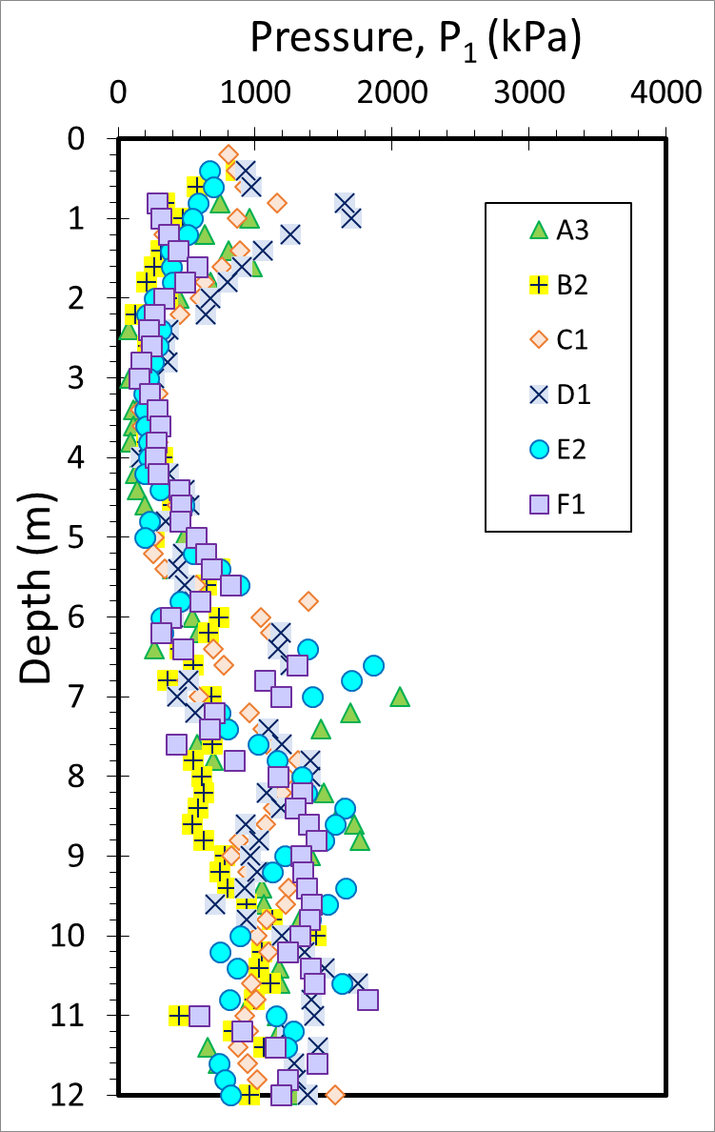
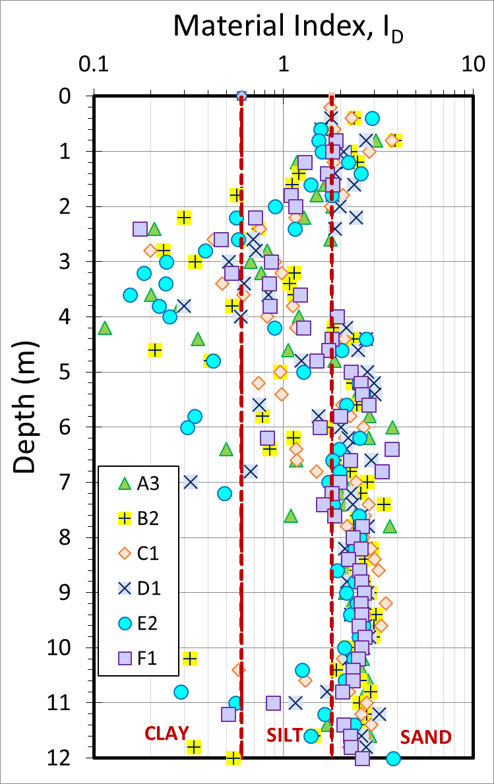
DMTs at Bolivian Test Site, Santa Cruz
Summary from 6 DMT soundings

Slide 12
Shallow Foundation Settlements
(Poulos & Davis 1974; Mayne & Poulos, 2001; Mayne 2019)
s_{c} = settlement
q = footing stress
d = width
I_{H} = elastic factor
ν = Poisson's ratio
E' = soil modulus
Rectangular Foundation
width, d
s_{c}
length, c

Slide 13
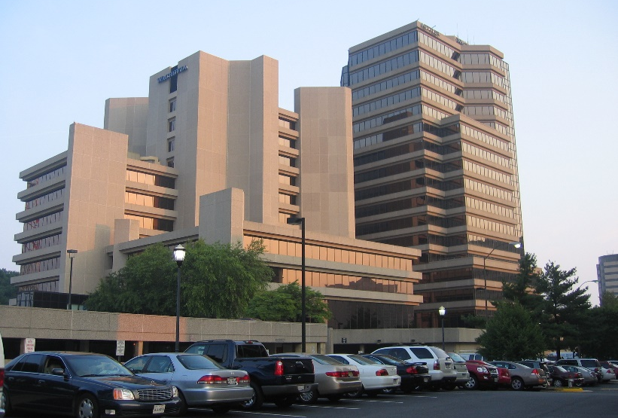
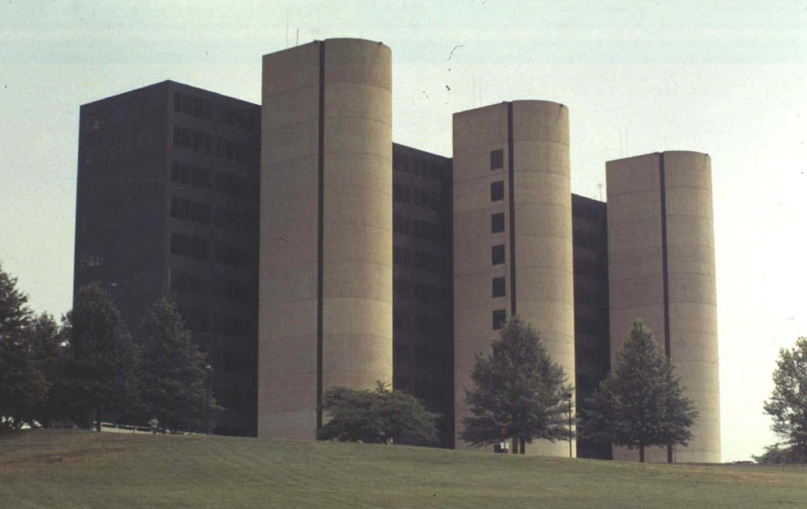

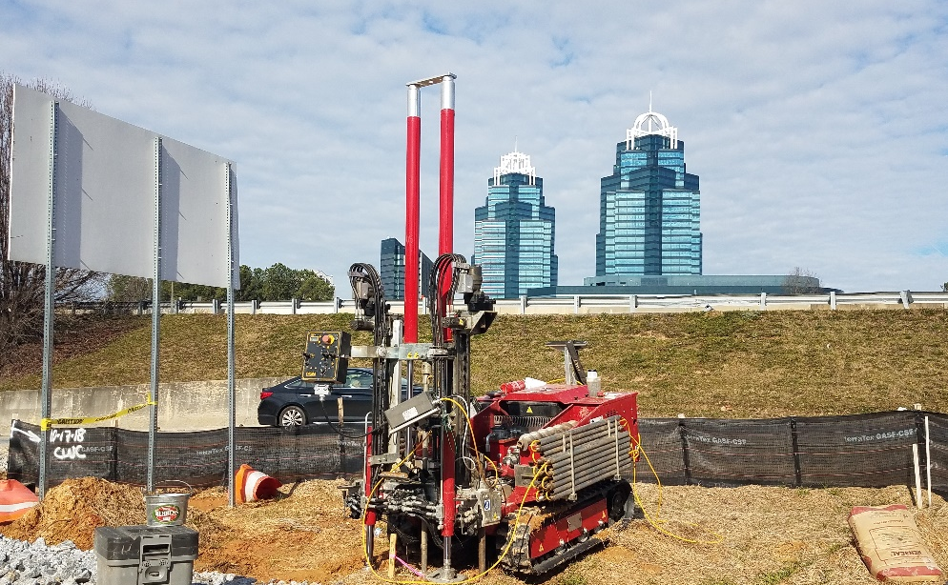
Raft Foundations on Appalachian Piedmont Soils
Wells Fargo Bank, Virginia
National Automobile Dealers Association
Georgia State University Dorm, Atlanta
North Perimeter & 400 MSE Wall, Georgia

Slide 14
Raft Foundations on Appalachian Piedmont Soils
Residual sandy Silts
to silty fine sands

Slide 15
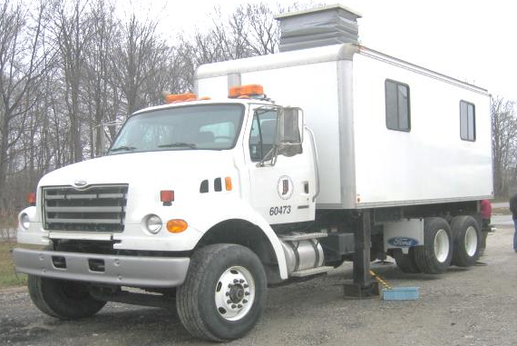
CONE PENETRATION TEST (CPT): ASTM D 5778
Cone
Truck
(20 tonnes)
ground surface
rods
depth recorder = z
rods (d = 36mm)
in one meter
lengths
electronic
piezocone
penetrometer
electric
cable
d = 36 mm
inclination = i_{xy}
d = 36 mm
or 44 mm
Constant
push rate of
20 mm/s
sleeve friction = f_{s}
porewater pressure = u₂
enlarge
penetrometer
measured cone resistance = q_{c}
readings every
1 or 2 seconds
total cone resistance = q_{t} = q_{c +} (1-a_{net})∙u₂
where 0.35 ≤ a_{net} ≤ 0.90 depends on equipment

Slide 16
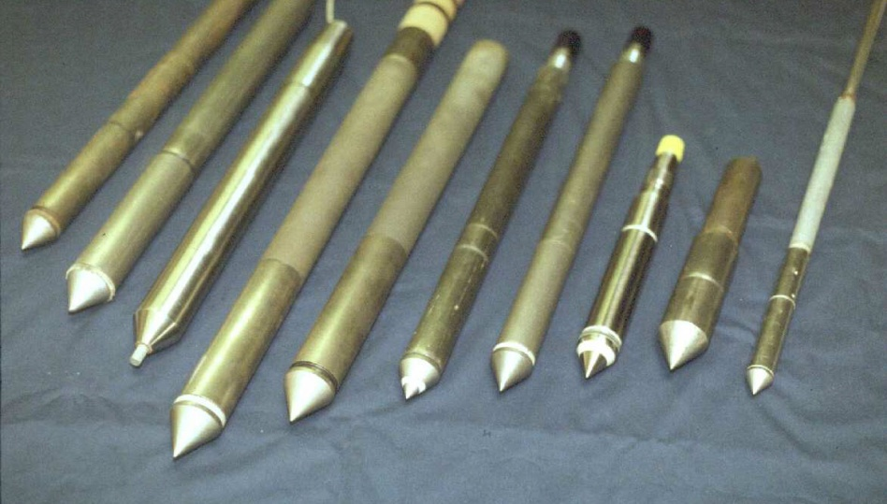
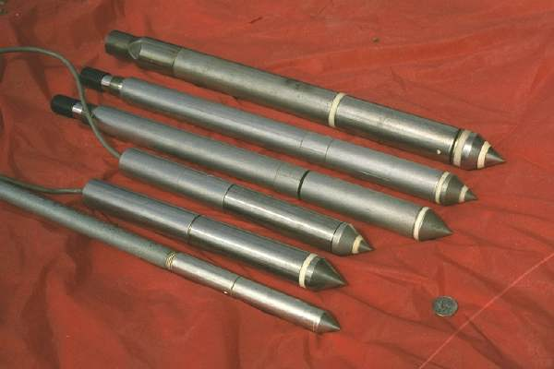
Cone Penetration Test (CPT)
Electronic Steel Probes with 60° Apex Tip
ISO / CEN / ASTM D 5778 Procedures
Hydraulic Push at 20 mm/s
No Boring, No Samples, No Cuttings, No Spoil
Continuous readings of stress, friction, pressure
Immediate access to digital data for analyses

Slide 17
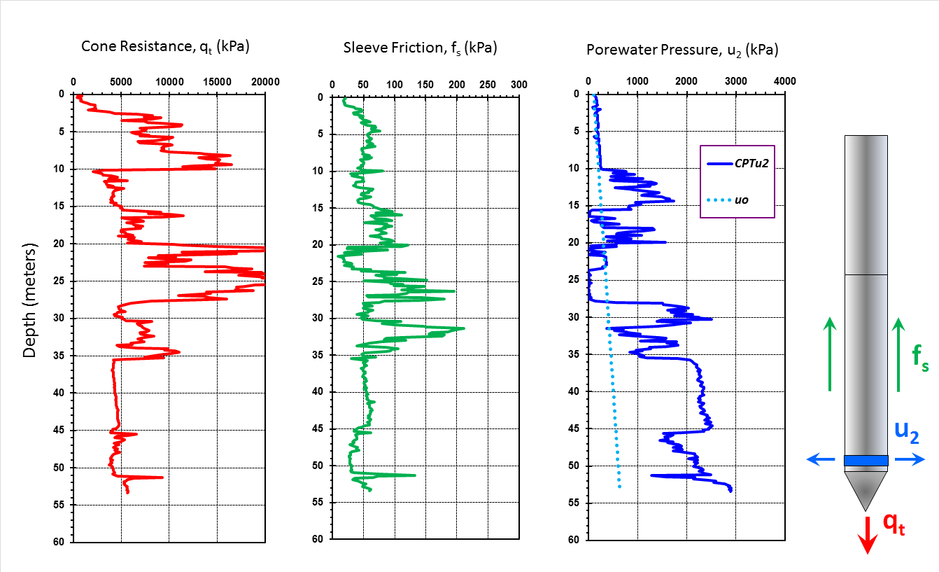
Geostratigraphy by CPTu in Portsmouth, Virginia

Slide 18
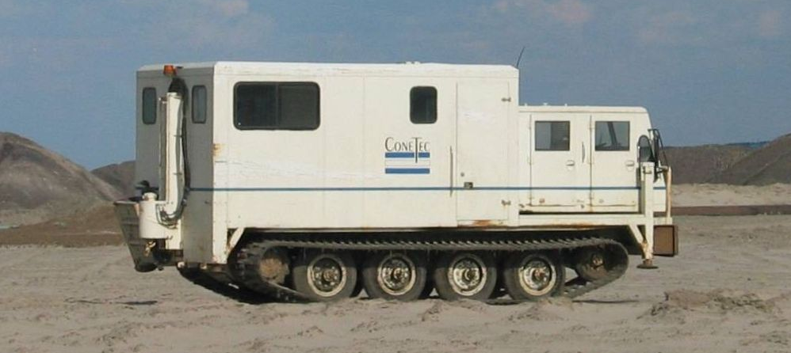
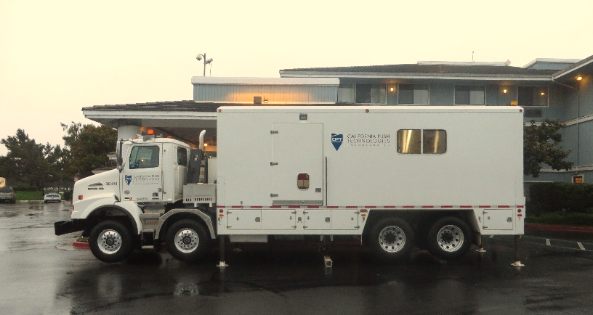
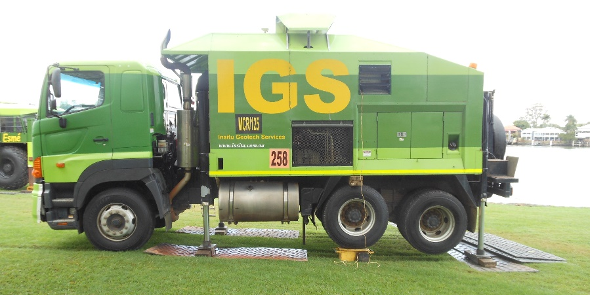
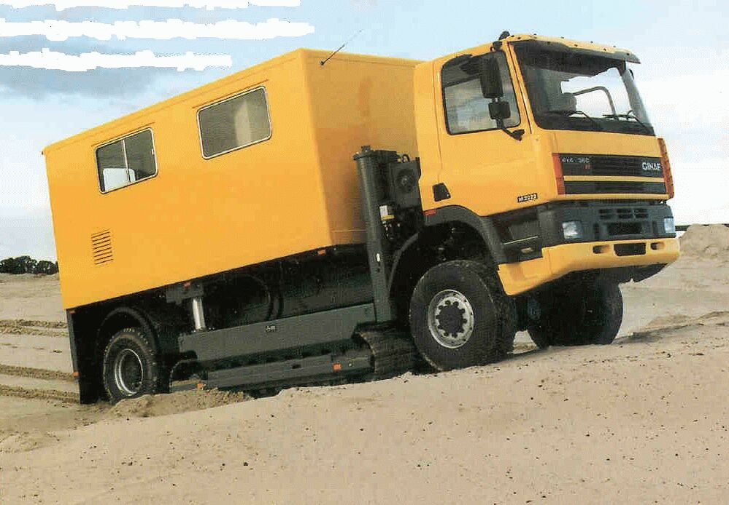
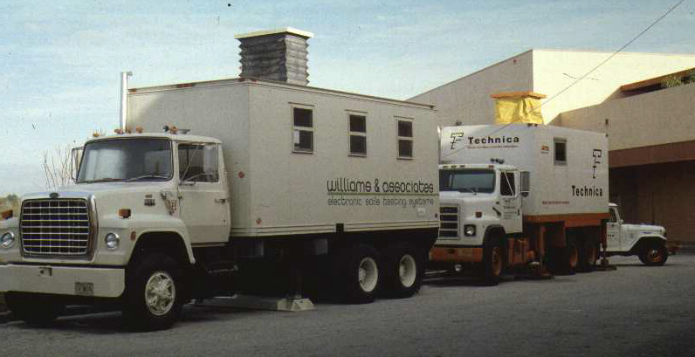
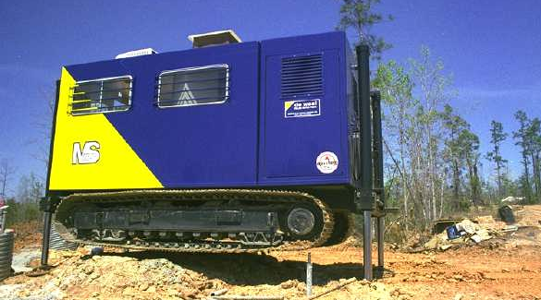
Cone Penetration Vehicles

Slide 19
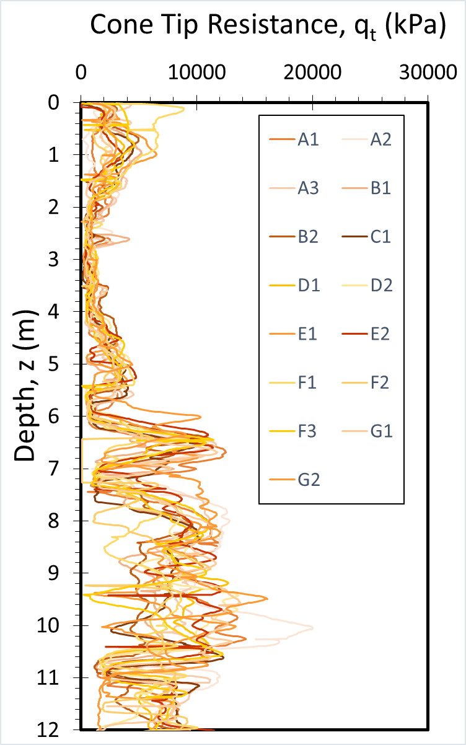
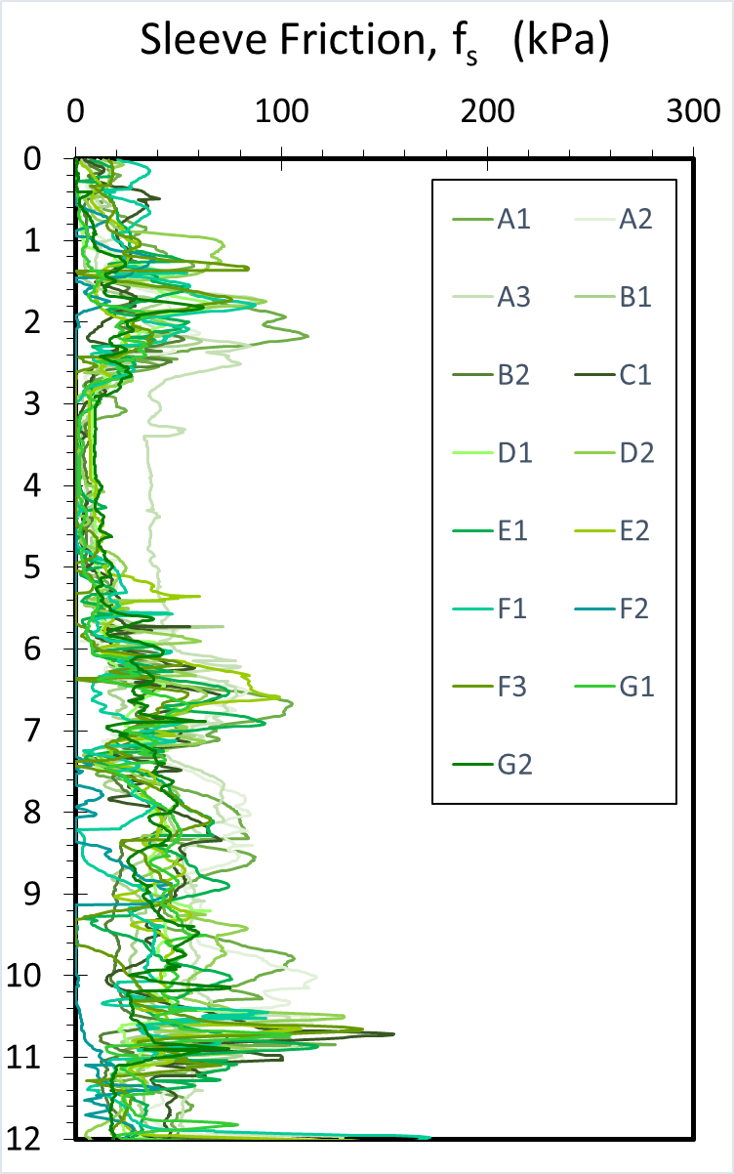
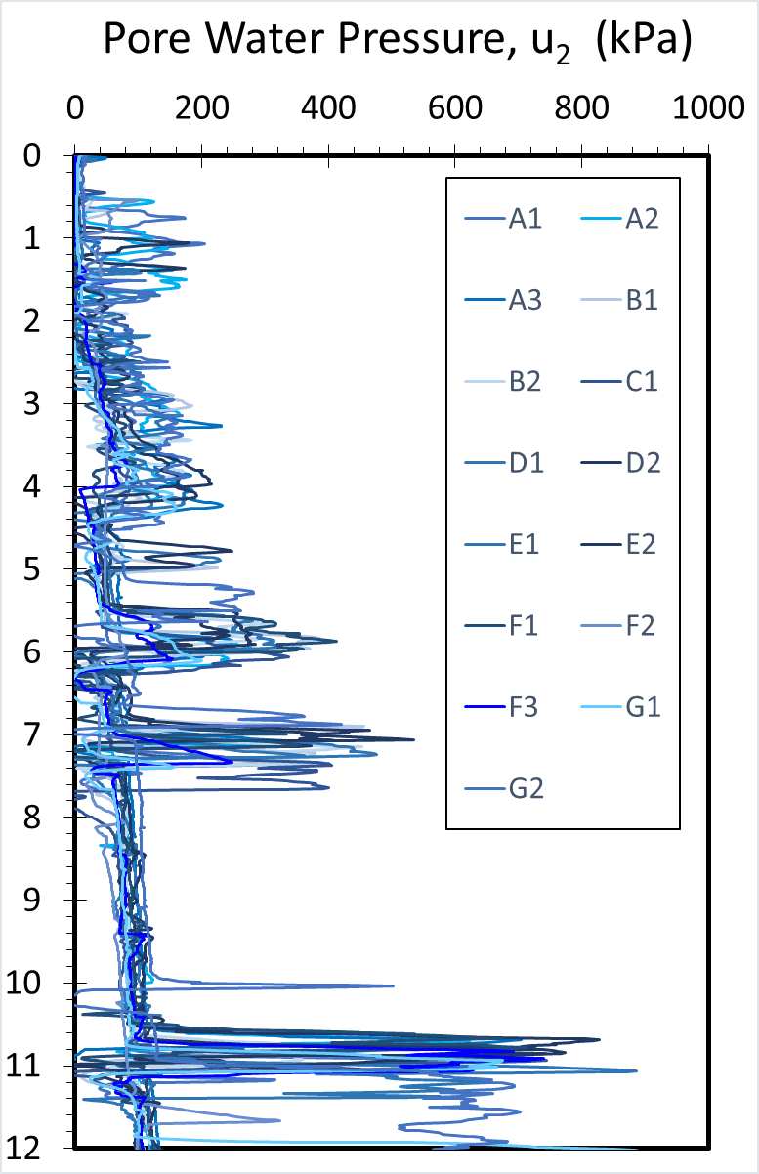
15 CPTUs from Bolivian Test Site, Santa Cruz

Slide 20
Axial Pile Capacity: Q_{total} = Q_{sides} + Q_{base}
Q_{t}
unit side
friction, f_{p}
Q_{s} = ∫ f_{p} dA_{s}
= shaft capacity
Q_{b} = q_{b} ∙ A_{b}
= base capacity
q_{b} = unit base resistance

Slide 21
Beta Method for Pile Side Friction
f_{p} = C_{M} ∙ C_{K} ∙ K₀ ∙ tanφ' ∙ σ_{vo}'
Pile Installation Effects Modifier, C_{K} | Jetted Pile | C_{K} = 0.5
 | Drilled and Bored Piles | C_{K} = 0.9
 | Low-Displacement Driven Piles: (e.g., H-piles; open-ended pipe) | C_{K} = 1.0
 | High-Displacement Driven Piles (e.g., closed-ended pipe; precast) | C_{K} = 1.1
Pile Material Effects Modifier, C_{M} | Soil/Rough Concrete (drilled shafts) | C_{M} = 1.0
 | Soil/Smooth Concrete (precast concrete) | C_{M} = 0.9
 | Soil/Timber (wood pilings) | C_{M} = 0.8
 | Soil/Rough Steel (H- and pipe pilings) | C_{M} = 0.7
 | Soil/Smooth Steel (cone penetrometer) | C_{M} = 0.6
 | Soil/Stainless Steel (flat dilatometer) | C_{M} = 0.5

Slide 22
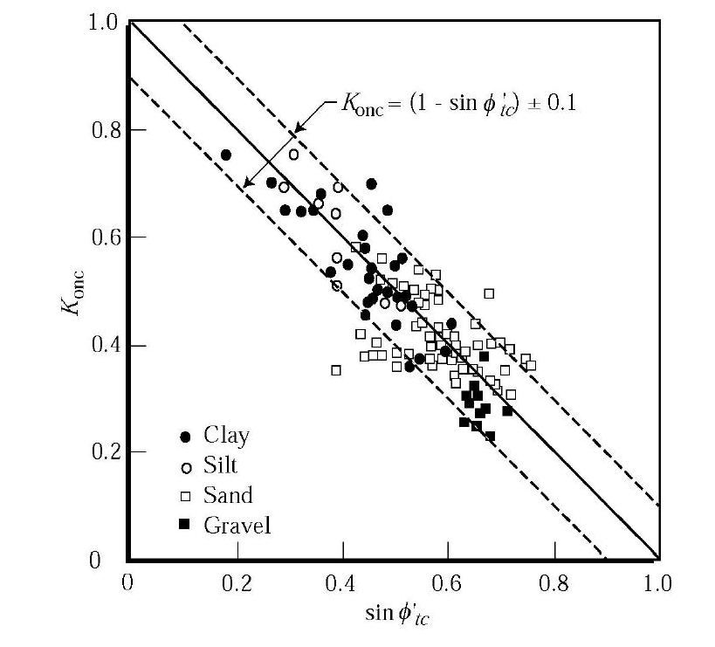
Lateral Stress Coefficient for NC Soils
(Jaky 1944, 1948)
K_{0NC} = 1 - sinφ' ± 0.01
Database from
Mayne and
Kulhawy (1982)
K_{0NC}
sinφ'

Slide 23
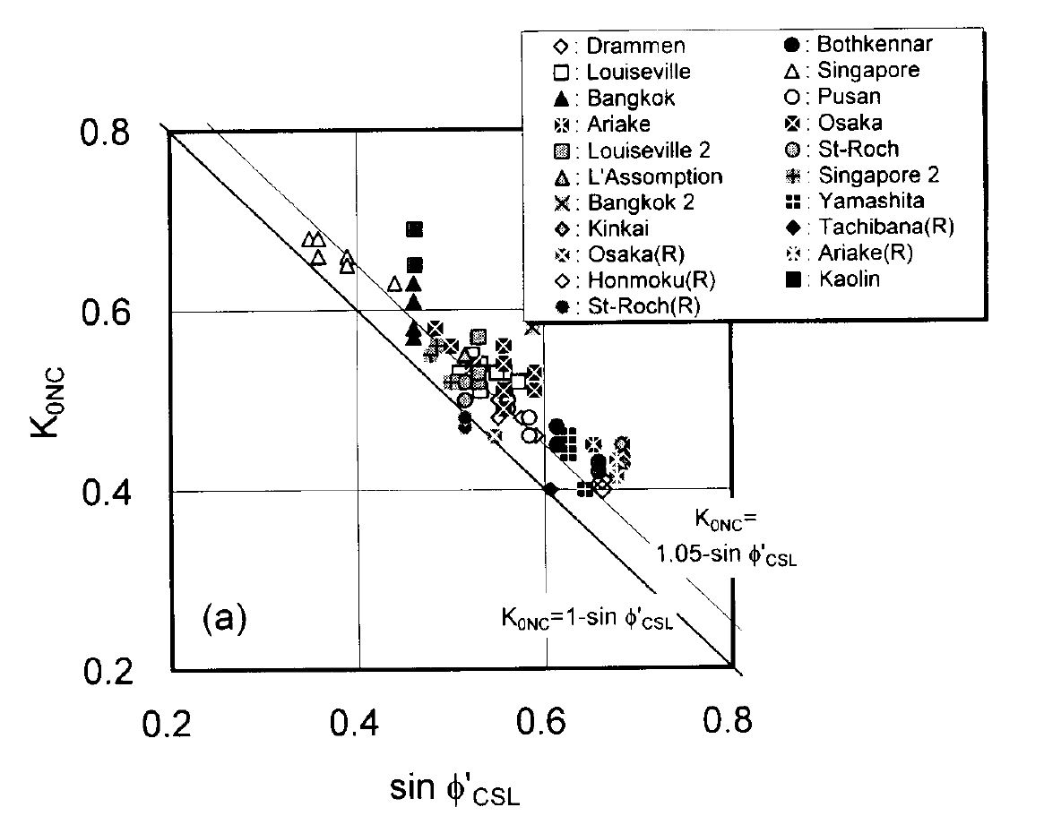
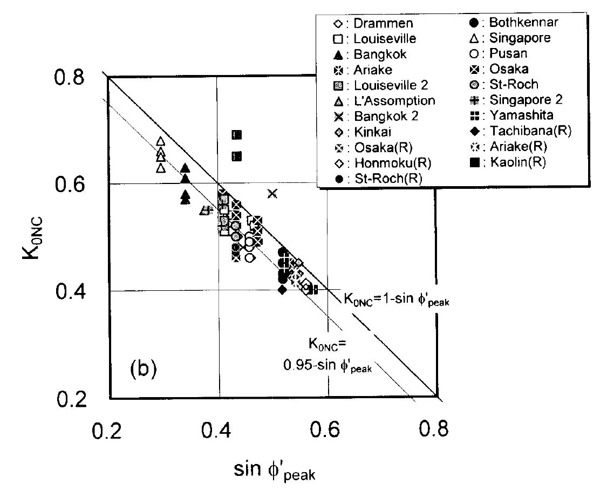
Lateral Stress Coefficient for NC Soils
(Jaky 1944, 1948)
K_{0NC} = 1 - sinφ'
(data on 21 clays tested by Watabe et al. 2003)

Slide 24
Clays: Lateral Stress Coefficient, K₀
Self-Boring Pressuremeter
SBP = Self-Boring Pressuremeter
TSC = Total Stress Cell
= φ'
Total Stress Cell

Slide 25
Sands: Lateral Stress Coefficient, K₀

Slide 26
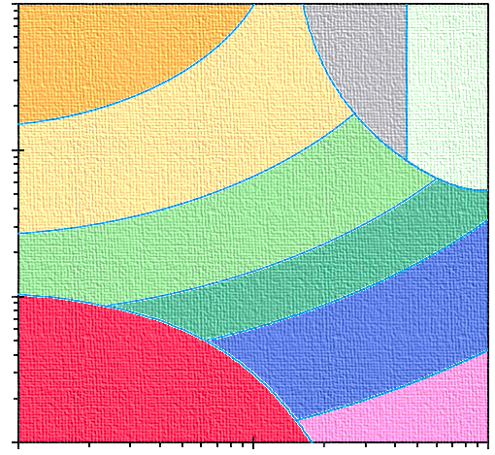
Nine-Zone Soil Classification (Robertson 1990, 1991, 2009)
Stiff
clayey
Sand
(Zone 8)
Gravelly to dense
SANDS (Zone 7)
Very
Stiff
clays
and
silts
(Zone 9)
SANDS
(Zone 6)
Sandy Mix
(Zone 5)
Silty Mix
(Zone 4)
CLAYS
(Zone 3)
Sensitive Soils
(Zone 1)
Organic
(Zone 2)

Slide 27
Soil Behavioral Type by CPT
Use of CPT Material Index (I_{c}) for identification of soil type (Robertson & Wride, 1998):
Modified normalized tip resistance (Robertson 2004):
Exponent n = 0.5 (sands), 0.75 (silts), n = 1.0 (clays)
Iterate to find exponent n (Robertson 2009 CGJ):
sands: I_{c} < 2.05
clays: I_{c} > 2.95

Slide 28
Soil Behavioral
Type (SBTn) Chart
for normalized CPT
(after Robertson 2009)
I_{c} < 2.6: Drained
I_{c} > 2.6: Undrained
Approximate
Algorithm Steps:
a. Find sensitive soils of zone 1 identified when: Q_{tn} < 12 exp(-1.4 F_{r} )
b. Identify: Zone 8 (1.5 < F_{r}< 4.5%) and Zone 9 (F_{r} > 4.5%):
c. Use CPT index I_{c} for Zones 2 through 7

Slide 29
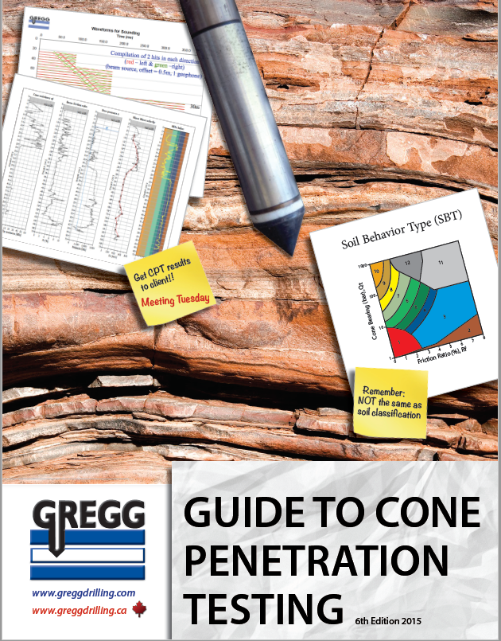
Preconsolidation or "Yield Stress" from CPT Net Cone Resistance
Robertson & Cabal (2015)

Slide 30
Yield Stress Exponent m’ Trend with CPT Material Index, I_{c}
Zone No. = 7 6 5 4 3 2
SANDS
Fissured
Clays
Intact Clays
SILTS
Silts
Quartz and
Silica Sands
For I_{c} < 3.5
CLAYS

Slide 31
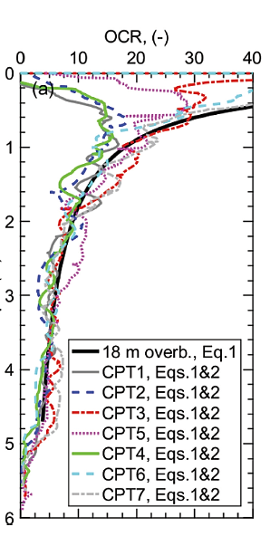
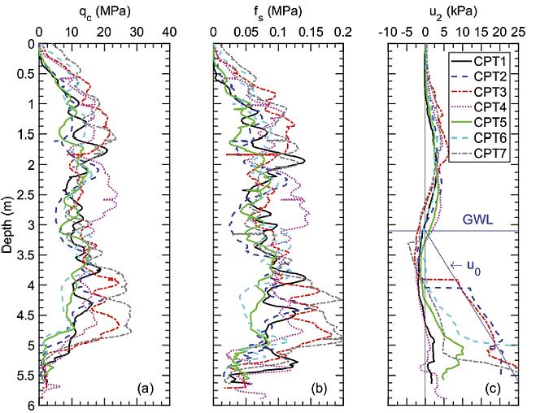
OC Sand at Cuxhaven, Germany
(Quinteros, Lunne, Krogh, et al. CPT'18)
Calculated OCR due to 18 m of overburden removal (quarried)
OCR
Sand
Clay

Slide 32
Undisturbed Sand Database
24 Sands to Silty Sands (n = 54 Triaxial Tests)

Slide 33
CPT evaluation of φ' in sands

Slide 34
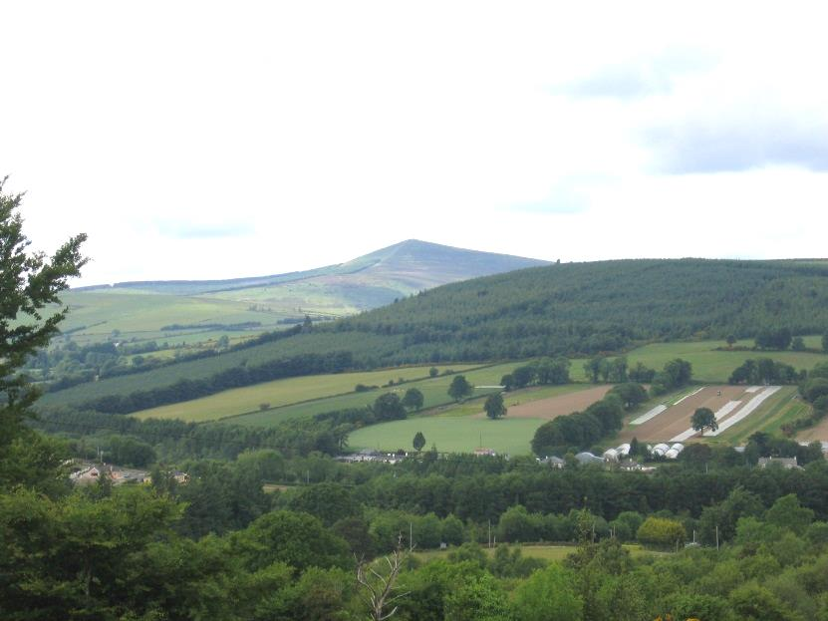
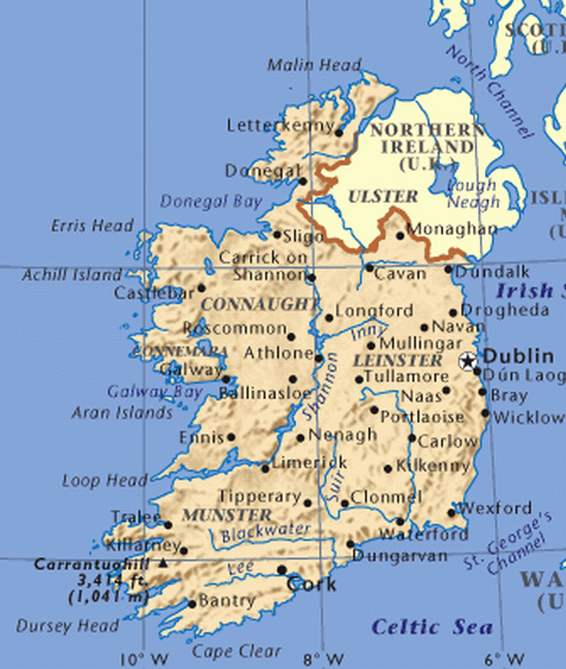

Blessington Sand Site
University of College Dublin (UCD)
Doherty et al. (2012)
Tolooiyan & Gavin (2011)

Slide 35
Blessington Sands, Ireland (Doherty et al 2012)
Dense OC Quartz Sands
D₅₀ ≈ 0.12mm

Slide 36
Blessington Sands, Ireland (Doherty et al 2012)

Slide 37


Principle of effective stress: σ' = σ - u
Triaxial Compression Piezocone Penetrometer
Axial Load:
q = σ₁-σ₃
cone
resistance
Filter Element
u₂
porewater
pressure
q_{t}
Cell Pressure
σ₃
σ₃
σ₃
Filter Element
Valve
z > 30m
Billions tested
pore pressure, u
Test one point
in space
Notes:
L: TX cell one point R: CPTu test infinite number of soil particles Put q on the TX part for CPTu, put qt, u2 bigger and full name

Slide 38
Norwegian NTH Solution for φ' from CPTu in Clays
(Janbu & Senneset 1974; Senneset et al 1989; Sandven 1990; Sandven et al. 2016)
Theory:
Approx: φ' ≈ 29.5°∙B_{q}^{0.121}∙[0.256 + 0.336∙B_{q} + log Q' ]
c' = 0
β = 0°
Approximation
Valid for:
0.1 < B_{q} < 1
20°< φ' < 45°
Theory (dots)
Approximation (lines)

Slide 39
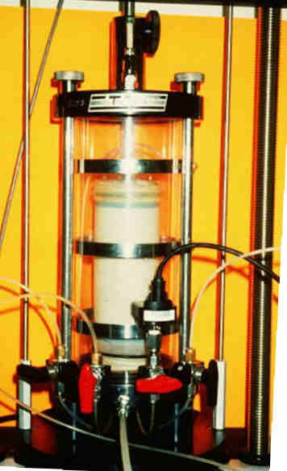
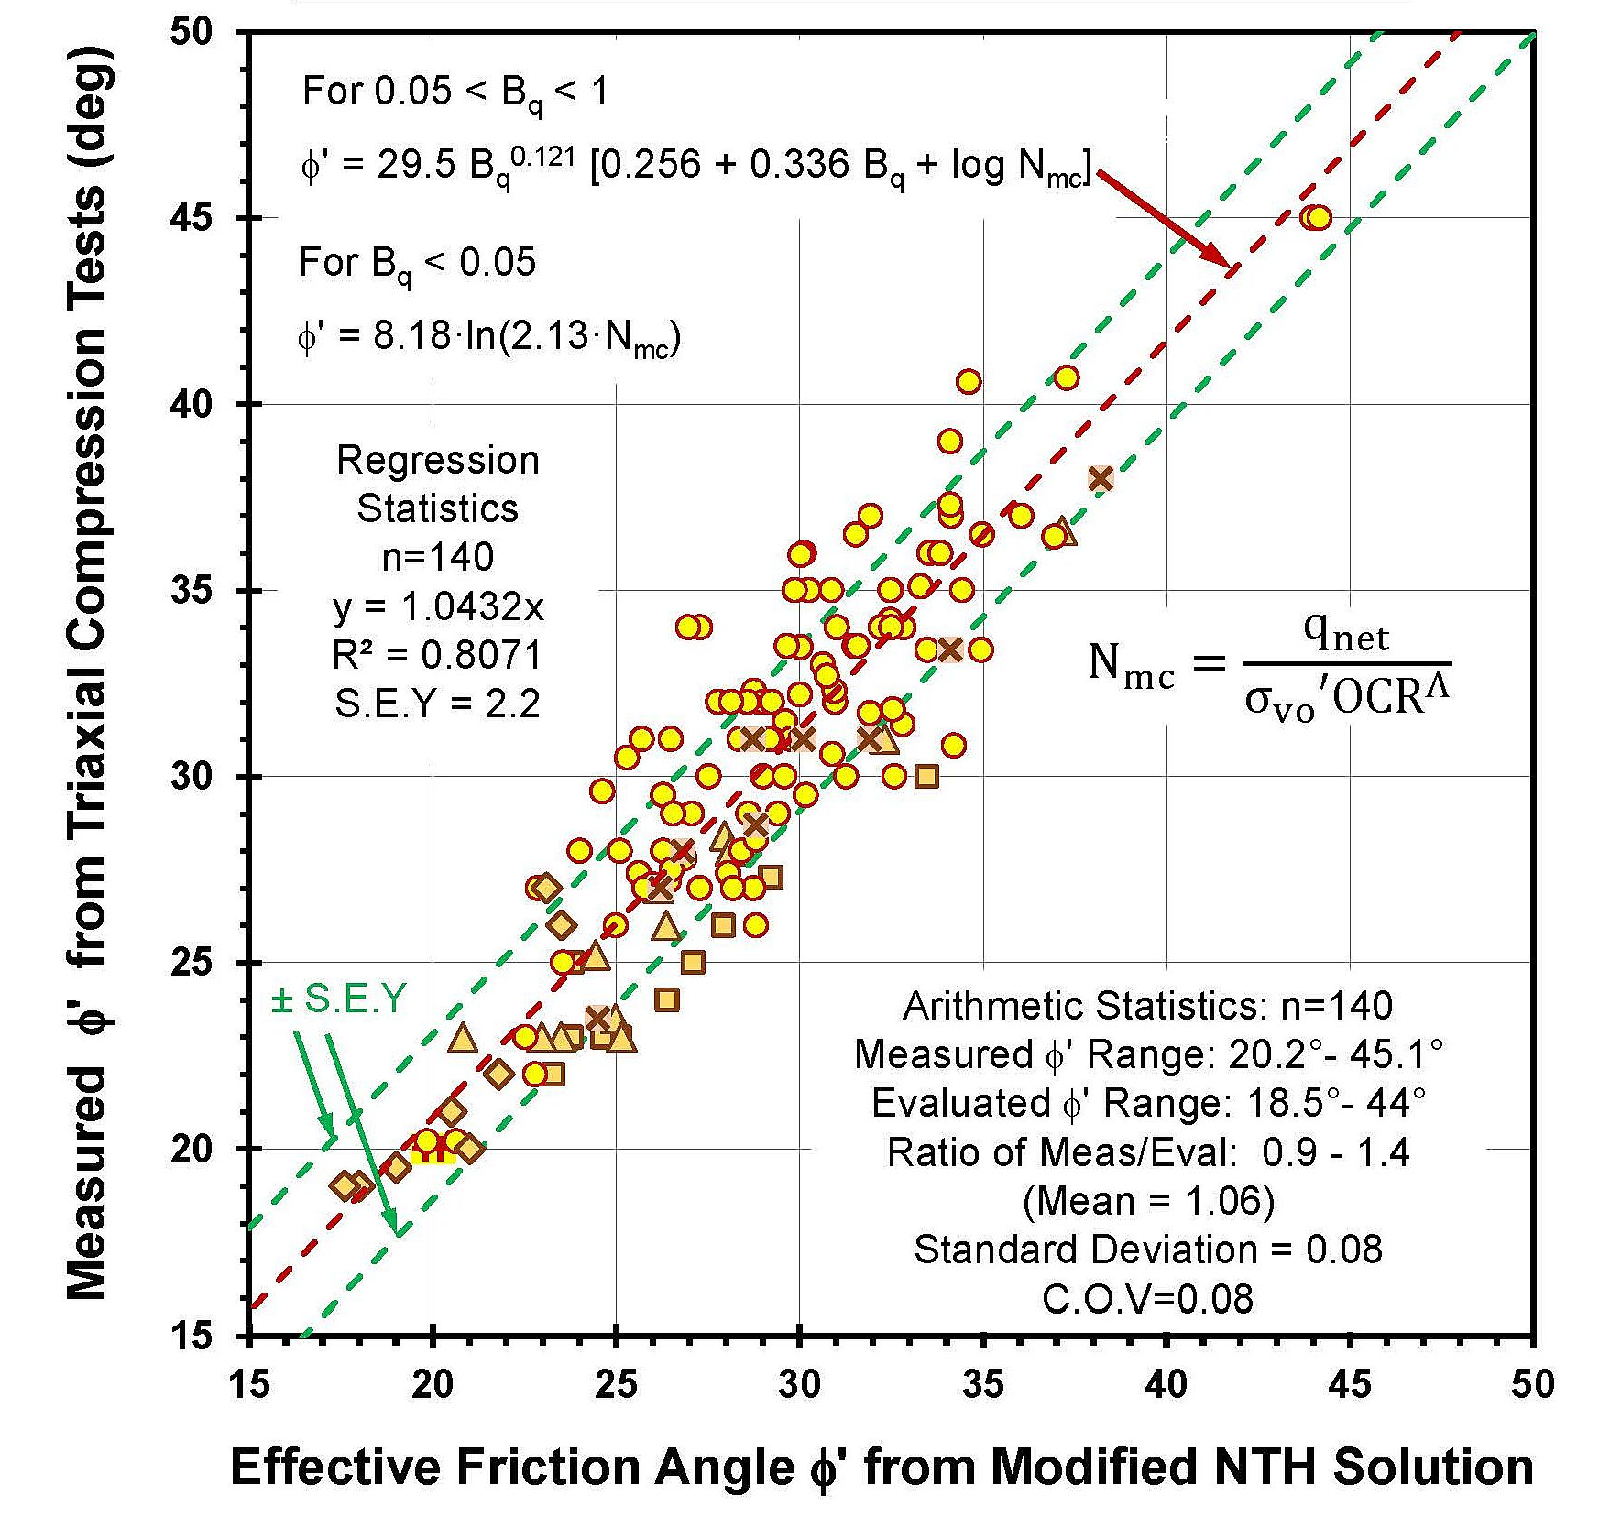

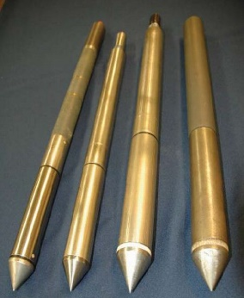
Comparison of Triaxial φ′ and Modified NTH φ′ from CPTu
(Ouyang & Mayne, CGJ 2018, JGGE 2019)
Calibrated for
over 140 Clays
Notes:
Strengthen the plots somehow

Slide 40

Port of Anchorage, AK
(Mayne & Pearce 2005)
OC
Clay
LL=45
PI=24
w=25
Notes:
Checking the soundings smoothed ones

Slide 41
OC Clay, Port of Anchorage, Alaska
(Ouyang & Mayne 2020)

Slide 42
OC Clay, Port of Anchorage, Alaska

Slide 43
OC Clay, Port of Anchorage, Alaska
ave φ' = 28°
OC
Clay
sandy clay layer

Slide 44
● Virgin Loading (Jáky 1944, 1948)
● Loading-Unloading (Mayne & Kulhawy, 1982)
● Load-Unload-Reload (Schmidt, 1983)
Evaluate K₀ from φ' and OCR

Slide 45
Effect of Overburden Removal by Excavation
Evaluate in-situ σ_{p}' = 0.33 q_{net}^{m'} (kPa) from CPT
Elevation (m)
Consequence: OCR increases

Slide 46
Shear Wave Velocity, V_{s}
Fundamental measurement in all solids (steel, concrete, wood, soils, rocks)
Initial stiffness represented by the small-strain shear modulus (G_{dyn} = G_{max} = G₀):
G₀ = ρ_{t} V_{s}² where total mass density ρ_{t} = γ_{t}/g_{a}
Applies to all static & dynamic problems at small strains (γ_{s} < 10⁻⁶); i.e. nondestructive range
Can convert to equivalent Young's Modulus:
  E = 2G(1+ν) where ν' = 0.2 drained ν_{u} = 0.5 (undrained)

Slide 47


Field Geophysics - Mechanical Wave Methods
Seismograph
+ Source
DHT
Oscilloscope
+ Source
Spectral
Analyzer
+ Source
SFLS
SFRS
Geophones
Cased
Boreholes
V_{s}RW
Receivers
V_{p}
high frequencies
V_{s}HH
UHT
medium frequency
content
V_{s}VH
SRFS = Surface Refraction Survey
SFLS = Surface Reflection Survey
SASW = Spectral Analysis of Surface Waves
MASW = Modal Analysis (Rayleigh Waves)
CSW = Continuous Surface Waves
PSW = Passive Surface Wave Testing
ReMi = Reflection MicroSeis
SLP = Suspension Logger Problng
CHT = Crosshole Test
RCHT = Rotary Crosshole
DHT = Downhole Test
UHT = Uphole Test
SCPTu = Seismic Piezocone Test
SDMT = Seismic Flat Dilatometer Test
BTSD = Borehole Torsional Shear Device
Vertical
Source
V_{s}HV
CHT
low
frequency
content
V_{s}HH
RCHT
Rotary
Source
Rayleigh Wave Methods
Torsional
Source
BTSD
SLP
SASW
MASW
CSW
PSW
ReMi
V_{s}HH
V_{s}VV

Slide 48




DIRECT-PUSH TECHNOLOGY
Seismic
Piezocone
Penetrometer
Seismic Flat
Dilatometer
firm sand
soft to firm
clays
SCPTù
V_{s} = shear wave velocity
t₅₀ = time for 50% consolidation
f_{s} = sleeve friction
u₂ = porewater pressure
q_{t} = cone resistance
SDMTà
V_{p} = P-wave velocity
V_{s} = S-wave velocity
t_{flex} = time rate consolidation
p₁ = expansion pressure
p₀ = contact pressure

Slide 49


Downhole Test Wavelets - Windsor, VA
RED LINES = right strikes
BLUE LINES = left strikes

Slide 50



GT Roto AutoSeis
Electro-Mechanical off 12-volt
AC or DC power; variable speed
Repeatable and Portable
Reach to 30-m depths
Can generate shear wavelets every 1 second
US Patent in February 2010
Brisbane, Australia

Slide 51
Continuous Interval Seismic Piezocone Tests
Norfolk, Virginia, USA
Norfolk
Formation
Yorktown
Formation

Slide 52
Modulus Reduction from TS and TX Data
(TS = torsional shear; TX = triaxial shear)
Open = Drained
Closed = Undrained
FS = factor of safety
E = 2G(1+ν)
= 1/FS

Slide 53
Modulus Reduction Scheme (Fahey & Carter 1993)
Operational modulus: E = (E/E_{max})·E_{max}
E = 2G(1+ν)
= 1/FS

Slide 54
Nonlinear Foundation Displacement Analyses
where
q = applied surface stress;
q_{ult} = ultimate bearing stress;
d = equivalent footing diameter
I_{G}, I_{F}, I_{E} = elastic factors for modulus variation, rigidity, and embedment, respectively.
ν = Poisson’s ratio
E_{max} = initial elastic modulus = 2G_{max} (1+ν)
See Mayne & Poulos (ASCE J. Geot. Engrg. - Jan 2001)

Slide 55

UNDRAINED: q_{ult} = *N_{c} s_{u}
where *N_{c} = 5.14 for strip footing;
5.65 for rectangle (c/d = A/B = 2).
6.14 for square or circular footing.
DRAINED: q_{ult} = ½ B γ* N_{γ}*

Slide 56

Class “A” Prediction
Texas A&M Test Site
ASCE and FHWA Symposium
Geotechnical
Special Publication
GSP No. 41
Measured and Predicted Behavior of Five Spread Footings on Sand

Slide 57

Footing Load Tests at Texas A&M University (Briaud & Gibbens 1999; Briaud 2007)

Slide 58
Footing Load Tests at Texas A&M University (Briaud & Gibbens 1999; Briaud 2007)

Slide 59
FHWA-ASCE Load Tests at Texas A&M

Slide 60

Class “A” Prediction
Belfast Footing Load Test, Ireland
(June 2001)
Conducted by Trinity College, Univ. Dublin (Lehane, 2003))
Prediction submitted
by Mayne (2003)

Slide 61
Belfast Footing Load Test, Ireland (Lehane 2003)
Square Footing: B = 2.0 m and thickness t = 1.7 m

Slide 62

Belfast Footing Load Test, Ireland (Lehane 2003)
Elastic solution with SCPTU data (Mayne 2003)

Slide 63



Footing Load Test Prediction, Ballina, Australia
(Gaone et al. 2018; Doherty et al. 2018)

Slide 64



Footing Load Test Prediction, Ballina, Australia
(Gaone et al. 2018; Doherty et al. 2018)
Square Footings: B = 1.8 m
situated 1.4 m deep

Slide 65
Footing Load Test Prediction, Ballina, Australia
GT Prediction Submission (Agaiby & Mayne 2016)

Slide 66

Evaluating Shallow Foundation Response from CPT
Conventional Approach
Direct CPT Approach
Bearing Capacity Settlements CPT
footing
B
B
B
q_{footing} = stress
III
I
III
Δσ_{z}
s = displacement
II
II
Elastic
Continuum
Theory
Limit Plasticity
q_{ult} = bearing capacity
γ_{t} = unit weight
φ' = friction angle
s_{u} = undrained strength
c' = effective cohesion intercept
N_{c} = cohesion bearing factor
N_{γ} = unit weight bearing factor
N_{q} = surcharge bearing factor
soil type
s = displacement
ν = Poisson's ratio
E' = Young's modulus
D' = constrained modulus
E_{u} = undrained modulus
σ_{p}' = preconsolidation
I_{GHFE} = elasticity factors
f_{s} = sleeve friction
u₂ = porewater pressure
q_{t} = cone resistance → q_{net} = q_{t} - σ_{vo}

Slide 67
Direct CPT Method for Shallow Footing Foundations

Slide 68
RIGID PILE RESPONSE
P_{t} = P_{s} + P_{b} = Total Load
Randolph Model
Ground Surface
Top Displacement, w_{t}
d = diameter
L = Length
Elastic Solution:
Soil E_{s} and v
constant
with depth
Shaft
Load, P_{s}
Load Transfer to Base:
Base Load, P_{b}

Slide 69
Overview: UniCone CPTu Method
Eslami & Fellenius (1997 Canadian Geotech. J.)
www.fellenius.net
A. Determine effective cone resistance:
q_{E} = q_{t} - u₂
B. Plot q_{E} vs f_{s} to determine soil zonal type
C. Unit Side Resistance:
r_{s} = C_{se}∙q_{E}
D. Unit Tip Resistance:
B < 0.4m: r_{te} = q_{E}
B > 0.4m: r_{te} = q_{E}/(3B)
where B = pile width (m)
Soil Zone Type C_{se} Coefficient
1. Soft sensitive soils 0.080
2. Soft Clay 0.050
3. Stiff clay to silty clay 0.025
4. Silt-Sand Mixtures 0.010
5. Sands 0.004

Slide 70

Summary of 40 available direct CPT methods

Slide 71

Enhanced Unicone Method (Niazi & Mayne 2016)
North America (40 Sites)
Canada: 11 Sites
USA: 28 Sites
Puerto Rico: 1 Site
Europe (21 Sites)
Belgium: 2
France: 4
Ireland: 3
Netherlands: 2
Norway: 2
Portugal: 1
United Kingdom: 7
Unicone Method (1997): 102 load tests
Enhanced Unicone (2016): 330 load tests
www.mapcruzin.com
Overview
330 pile load tests
70 sites
19 countries
CPT Soundings
SCPT/SCPTu: 59
CPTu: 9
CPT: 4
Asia (7 Sites)
China: 2
Iraq: 1
Japan: 2
Malaysia: 1
Thailand: 1

Slide 72
Enhanced Unicone: Pile Side Friction: f_{p} = C_{se}·q_{E}
C_{se} = C_{se(mean)} ∙ θ_{PileType} ∙ θ_{t-c} ∙ θ_{rate}
SIDE FRICTION
Pile Type:
Bored Piles: θ_{PileType} = 0.84
Jacked Piles: θ_{PileType} = 1.02
Driven Piles: θ_{PileType} = 1.13
Direction of Loading:
Rate of Loading:
Compression: θ_{t-c} = 1.11
Tension/Uplift: θ_{t-c} = 0.85
CRP: θ_{rate} = 1.09
MLT: θ_{rate} = 0.97
CRP = constant rate
of penetration
MLT = maintained load test
Pile End Bearing Resistance: q_{b} = C_{te(mean)}·q_{E}

Slide 73
RIGID PILE RESPONSE
Randolph Solution
Q_{ult} = Q_{s} + Q_{b}
Q_{s} = Σ (r_{s} dA_{s})
SCPTU
AXIAL PILE
Q_{b} = r_{t} A_{b}
V
Top Displacement, w_{t}
unit side friction, r_{s}
V_{s} E_{max} = 2 ρ_{t} V_{s}² (1+ν)
f_{s}
I_{c} = fctn (q_{t} and f_{s})
u₂
r_{s} = fctn (q_{t}-u₂ and I_{c})
Load Transfer to Base
q_{t}
r_{t} = fctn (q_{t}-u₂ and I_{c})
r_{t} = unit end bearing

Slide 74

NGES
Treasure Island, CA
Northwestern University, Evanston, Illinois
Univ. Mass Amherst
Texas A&M,
Opelika AL (Auburn Univ)
Univ. Houston

Slide 75


Load Test of Augercast Pile in Beaumont Clay
Seismic Piezocone Sounding, University Houston
Stiff
Beaumont
clay
Fissured
Clay
d = 0.46m
L = 15.2m
Very stiff
sandy
clay
(Montgomery
Formation)

Slide 76
Auger Cast-in-place Piles at Univ. Houston
Elastic Continuum Pile Solution
Elastic Influence Factor:
Pile Displacements:
Load Transfer:
(O'Neill, 2000)

Slide 77
Auger Concrete Piles at UH (O'Neill, 2000)

Slide 78

Georgia Tech CPT Rig at I-85 Bridge, Newnan, Georgia
Instrumented drilled shaft load test: d = 0.91m L = 19.2m

Slide 79
SCPTu at I-85 Bridge, Newnan, Georgia
u₂ (kPa)
Residual
Soils:
sandy SILTS
and
silty
SANDS

Slide 80
Axial Load Response of Drilled Shaft, Newnan, Georgia
d = 0.91 m
L = 19.2 m
Q_{t}
Q_{s}
Q_{b}

Slide 81
SCPTU sounding at Texas A&M University
(Briaud & Gibbens 1999; Briaud 2007)
Drilled
Shaft
d = 0.91m
L = 10.4m

Slide 82
Drilled Shaft Load Test, Texas A&M
(Briaud, Ballouz, and Nasr, 2000)
L = 10.4 m
d = 0.914 m

Slide 83
Drilled Shaft Load Test, Texas A&M
(Briaud, Ballouz, and Nasr, 2000)

Slide 84


Input Parameters for Plaxis FEM
(Schweiger 2012): Hardening Soil Small Model
Input from SCPTu
√ SBT or f_{s}
√ V_{s} or f_{s}
√ q_{t1}
√ NTH N_{m}
√ q_{t1}
ν' = 0.2; ν_{u} = 0.5
√ V_{s} and Q_{tn}
√ I_{c} and Q_{tn}
√ V_{s} and Q_{tn}
√ I_{c}
σ_{atm} = 100 kPa
√ q_{t}, OCR, φ'
-
-
√ V_{s}
-

Slide 85

SCPTu from Perth, Australia
(Schneider, et al. 2004; Low et al. 2011)
Burswood
Soft
Clay

Slide 86
DSS curves for Burswood by SCPTu
(Data from Low, 2004: Univ. Western Australia)
τ = G ∙ γ_{s}
G/G_{max} = 1 - (τ/τ_{max})^{0.25}
τ_{max} = s_{u} = ½sinφ'OCR^{Λ}σ_{vo}'
OCR = 0.33(q_{t}-σ_{vo})/σ_{vo}'
G_{max} = ρ_{t} V_{s}²

Slide 87
CREC Site, Charleston, SC (Esposito, Andrus & Camp 2014)
Frozen Sand Samples Taken
Clean
Sand (SP
and SP-SM)
Sand with
clay & shells
(SP-SC)
silty
Sand
(SM)
(marl)

Slide 88

CREC Site, Charleston, SC
Sand sampled using freezing
(Esposito & Andrus 2016 JGGE)
SCPTu
SCPTu

Slide 89




Seismic Piezocone Test - Memphis, TN

Slide 90
Evaluating Foundation Response by CPT
CPT readings for evaluating indirect and/or direct capacity of shallow and deep foundations
Elastic solution for pilings (Randolph 2003)
Elastic solution for shallow foundations (Mayne & Poulos 2001)
Role of SCPTU providings: q_{t}, f_{s}, u₂, and V_{s}
Fundamental stiffness: G_{max} = ρ_{t} V_{s}² and E = 2G(1+ν)
Nonlinear modulus algorithm by Fahey (2004)
Nonlinear load-displacement-capacity response
Selection of case studies

Slide 91





